Slide 1

Chapter 2
Process and Methodology
Dr. Lo’ai Tawalbeh

Slide 2
Key Takeaway Points
A software process defines the phases of activities or what need to be performed to construct a software system.
A software methodology details the steps or how to perform the activities of a software process. A methodology is an implementation of a process.
Software development needs a software process and a methodology.

Slide 3
Challenges of System Development
Project Reality 1. Many systems require many years to develop.
      Project Challenge 1. How do we schedule, and manage the work without knowing exactly what the customer wants, and what may happen in the future?
Project Reality 2. Many software projects require collaboration of multiple departments and teams.
Project Challenge 2. How do we divide the work among the departments and teams, and integrate the components produced by them?
Project Reality 3. Different departments or teams may use different processes, methods, and tools. They may reside at different locations.
Project Challenge 3. How do we ensure proper communication and coordination among the departments and teams?

Slide 4
Challenges of Systems Development
System Reality 1. Many systems need to satisfy numerous requirements and constraints.
System Challenge 1. How do we develop systems to ensure that the requirements and constraints are met?
System Reality 2. Requirements and constraints may change from time to time.
System Challenge 2. How do we design the processes and the products to cope with change?
System Reality 3. A system may consist of hardware, software and third party components using different programming languages and run on multiple platforms and machines located at different places.
System Challenge 3. How do we design the system to hide these differences?

Slide 5

Properties of a Tame Problem
A tame problem can be completely specified and there is a stopping rule.
For a tame problem, the specification and the solution can be separated and the solution can be evaluated ( correct or wrong).
The solution process is a scientific process and each step of the problem-solving process has a finite number of possible moves.
The solution can be adapted for solving similar problems.
These is a definite chain of cause-effect reasoning.
The solution can be tested immediately; once tested, it remains correct forever.
If the problem is not solved, simply try again.
Notes:
https://copip.wordpress.com/2013/04/13/tame-problems-and-wicked-problems/

Slide 6
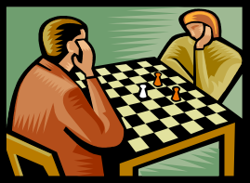





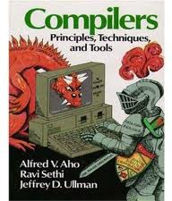

Examples of Tame Problem
Operations research
Chess playing
Math problems
Many computer science problems
Query optimization
AI problems
Why are these tame problems?
Operating systems
Compiler construction

Slide 7
Software Development Is a Wicked Problem
A wicked problem does not have a definite formulation.
The specification and solution cannot be separated.
There is no stopping rule – you can always do it better.
The solutions can only be evaluated in terms of good or bad, and the judgment is usually subjective.
Each step of the problem-solving process has an infinite number of choices – everything goes as a matter of principle.
Cause-effect reasoning is premise-based, leading to varying actions, but hard to tell which one is the best.
The solution is subject to life-long testing.
Every wicked problem is unique.
The problem-solver has no right to be wrong because the consequence is disastrous.

Slide 8


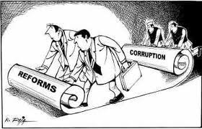
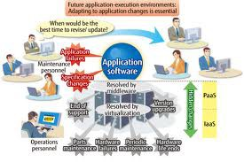

Examples of Wicked Problem
Urban planning
National policy making
Why are these wicked problems?
Application software development
Economic reforms

Slide 9
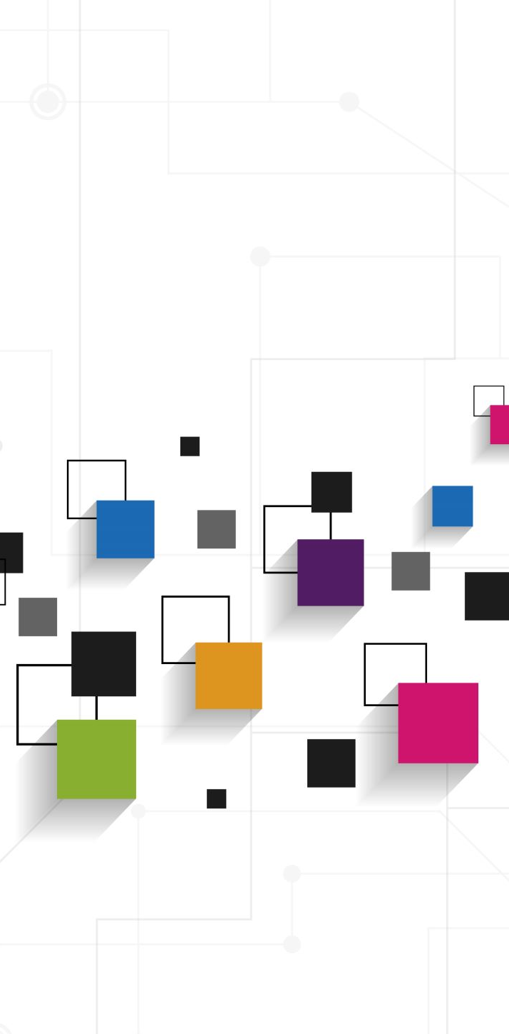
Software Process
System development challenges call for an engineering approach for software development. A software process is required.
Definition 2.1 A software process defines a series of activities performed to construct a software system. Each activity produces some artifacts, which are the input to other phases.
Each phase has a set of entrance criteria and a set of exit criteria.

Slide 10

Software Process Models
Water Fall Model
Prototyping Process Model
                Throwaway prototype
                Evolutionary prototype
Spiral Process Model
Incremental Model
Personal Software Process Model

Slide 11
The Waterfall Process
System Engineering
Software Requirements Analysis
Software Design
Coding & Unit Testing
Integration & Integration Testing
Acceptance Testing
Maintenance

Slide 12
The Waterfall Model

Slide 13
Advantages and disadvantages of the Waterfall Model
Advantages:
The simple, straight sequence of phases of the waterfall simplifies project management.
It supports function-oriented project organization:
  Each project is carried out by a pipeline of functional teams.
  Each functional team is specialized in one function such as requirements analysis, design, implementation, integration and testing, and so forth.
Disadvantages
It is inflexible to requirements change.
The long development duration might cause delay in delivery.
The customer has to wait until the entire system is implemented and deployed to reap the benefits.
The customer may lose the entire investment if the project fails.

Slide 14

Prototyping Process Model
Prototypes of the software system are constructed to:
  acquire and validate requirements
  assess the feasibility of the project and/or the feasibility of the requirements and constraints
Simple prototypes as well as sophisticated prototypes are used, depending on the needs of the project.
Prototypes are classified into throwaway prototypes and evolutionary prototypes.

Slide 15
Evolutionary Prototyping Model
Throwaway prototypes waste time and effort.
Evolutionary prototyping model lets the prototype evolve into the production system.
Suitable for development of exploratory types of systems such as intelligent systems, research software, and interactive systems (e.g. environment control)
Not suitable for projects that require a predictable schedule of progress.

Slide 16
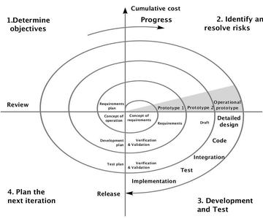
Spiral Process Model

Slide 17
Incremental development

Slide 18
Incremental development benefits
The cost of accommodating changing customer requirements is reduced.
  The amount of analysis and documentation that has to be redone is much less than is required with the waterfall model.
It is easier to get customer feedback on the development work that has been done.
  Customers can comment on demonstrations of the software and see how much has been implemented.
More rapid delivery and deployment of useful software to the customer is possible.
  Customers are able to use and gain value from the software earlier than is possible with a waterfall process.

Slide 19
Incremental development problems
The process is not visible.
  Managers need regular deliverables to measure progress. If systems are developed quickly, it is not cost-effective to produce documents that reflect every version of the system.
System structure tends to degrade as new increments are added.
  Unless time and money is spent on refactoring to improve the software, regular change tends to corrupt its structure. Incorporating further software changes becomes increasingly difficult and costly.

Slide 20

Personal Software Process Model
PSP is a comprehensive framework for training software engineers.
It consists of scripts, forms, standards and guidelines used in the training.
It helps the software engineer identify areas for improvement.
It prepares the software engineer to work in a team project.

Slide 21
Personal Software Process Model
PSP framework consists of a series of predefined Processes:
  PSP0 & PSP0.1. These introduce process discipline and measurement including baseline, time recording, defect recording, defect type, coding standards, and process improvement.
  PSP1 & PSP1.1. These introduce size estimation, planning and scheduling.
  PSP2 & PSP2.1. These introduce quality management and design including code review and design review.
  PSP3.0. It guides component level development.

Slide 22
Process and Methodology
Methodology is often confused with process.
A process is a set of inter-related activities to be carried out to construct something (usually a system).
The activities are carried out in phases.
Each phase produces some products which are the input of the next phase.
The completion of each phase establishes a milestone.
A methodology implements a process or a phase in that process.

Slide 23
Methodology
A methodology is a cook-book for performing a task. It describes:
  steps to accomplish a series of subtasks
  input and output of each step
  representations of input and output
  entrance and exit conditions for each step
  procedures for carrying out each step
  methods and techniques used by each step
  relationships, or control flow and data flow between the steps

Slide 24
Process and Methodology
Process
Defines a framework of phased activities
Specifies phases of WHAT
Does not dictate representations of artifacts
It is paradigm-independent
.
Examples
Waterfall, spiral, and prototyping processes
Methodology
Defines steps to carry out phases of a process
Describes steps of HOW
Defines representations of artifacts (e.g., UML)
It is paradigm-dependent
Steps describe procedures, techniques & guidelines
A phase can be realized by different methodologies
Examples
Structured analysis/structured design (SA/SD), Object Modeling
Technique (OMT), Scrum, DSDM, FDD, XP, and Crystal Orange

Slide 25
Software Paradigm
A software paradigm is a style of software development that constitutes a way of viewing the reality.
Examples:
  procedural paradigm
  OO paradigm, and
  data-oriented paradigm

Slide 26
Three Paradigms in History
Procedural paradigm views the world and system as:
  a network of processes
  a process is refined by lower level processes
  basic building blocks and starting point are processes
OO paradigm views the world and system as:
  interrelated and interacting objects
  basic building blocks are objects
Data-oriented paradigm views the world and system as:
  interrelated data entities, processed by transactions
  basic building blocks are data entities and relationships

Slide 27

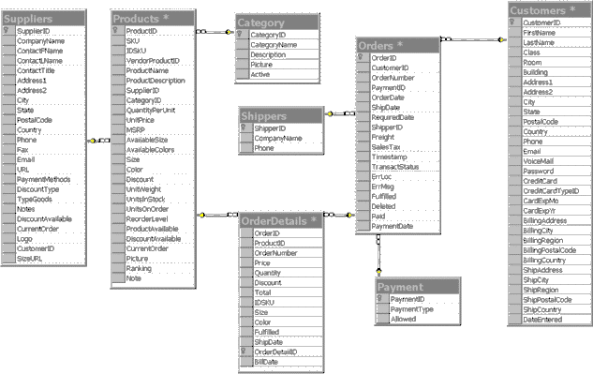
Paradigm and Methodology
Class - 1
Student
sn sname
attrib 1
attrib 2
Books
orders
enroll
Customer
Process
invoices
Orders
credit status
Class - 2
Class - 3
(w/books)
attrib 1
attrib 2
attrib x
cn cname
Student
Customers
Domain model
Object-Oriented Analysis
Obj: class b :Bclass
m1 ( ) m2 ( ) m3 ( )
Structured Analysis
Data-Oriented Analysis
Top Manager
A
Top Decider
BE
CF
DG
info
m5 ( )
m4 ( )
B
E C
F
D
G
m6 ( )
m7 ( )
m8 ( )
H
m10 ( ) m9 ( )
Sequence diagram
Object-Oriented Design
Object-Oriented Programming
OO Paradigm
Structured Design
Structured Programming
Procedural Paradigm
Data-Oriented Design
Programming in SQL
Data-Oriented Paradigm

Slide 28
Some Well-Known Methods (Methodologies)
Dynamic Systems Development Method (DSDM)
Scrum
Extreme Programming (XP)
Crystal Clear

Slide 29
DSDM Lifecycle Activities
Feasibility Study
Business Study
Agree schedule
User approval & user guidelines
Create functional prototype
Identify
Assess business impact
Functional
functional
Implemen- tation
Train users
model iteration _{prototype}
Review prototype
Deploy system
Review prototype
Identify design prototype
Create design prototype
Design & build iteration
Agree schedule

Slide 30
Scrum
Unique key features:
  include Scrum Master, Product Owner, and Team roles
  15 minute daily status meeting to improve communication
  team interaction to improve process

Slide 31
Scrum Lifecycle Activities
Release planning meeting
  identify and prioritize requirements, called product backlog
  identify top priority requirements to be delivered within an increment, called a sprint
  identify sprint development activities
Sprint iteration
  sprint planning meeting to determine what and how to build next
  daily Scrum meeting to exchange status
Sprint review meeting
  increment demo
  team retrospection
Deployment

Slide 32



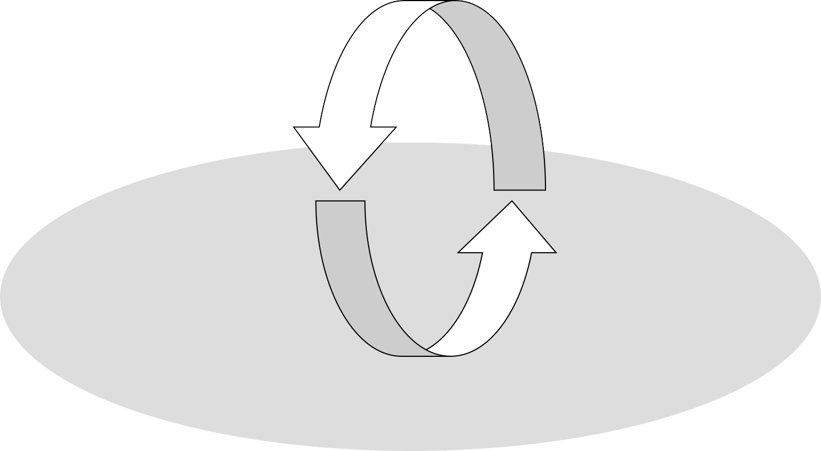

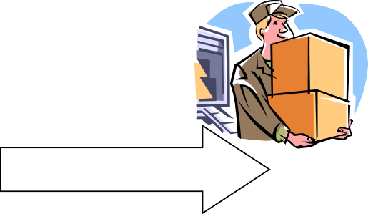
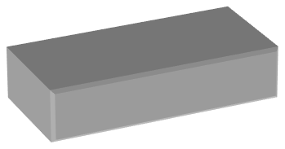

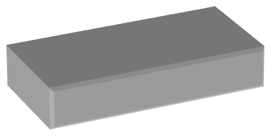


Scrum Process
Daily Scrum Meeting
Release Planning
Sprint Planning
2-4 Weeks
Sprint Retrospection
Potentially Shippable Product Increment
Product Backlog
Sprint Backlog

Slide 33
Extreme Programming (XP)
Unique Key Features:
  Anyone can change any code anywhere at any time
  Integration and build many times a day whenever a task is completed
  Work ≤ 40 hours a week

Slide 34






XP Lifecycle Activities
Collect information about the application
Conduct feasibility study
Exploration
Determine the stories for the next release
Plan for the next release
Planning
Define/modify architecture
Select and implement stories for each iteration
Perform functional tests by customer
Iteration to 1st Release
Productionizing
Evaluate and improve system performance
Certify and test system for production use
Maintenance
Improve the current release
Repeat process with each new release
Death
Produce system documentation if project is done, or
Replace system if maintenance is too costly

Slide 35
Cystal Clear Method
https://devcom.com/tech-blog/crystal-method-in-agile-development-an-in-depth-guide/

Slide 36




Methodology Overview – Planning Phase
Business goals & needs Current situation
Acquiring Requirements & Domain Modeling
Requirements
Deriving Use Cases from Requirements
Abstract & high level use cases,
use case diagrams
Allocating Use Cases & to Iterations
Use case-iteration allocation matrix
Producing an Architecture Design
Software architecture

Slide 37






Methodology Overview – Iterative Phase
Software architecture
Use case-iteration allocation matrix
Accommodating Requirements Change
Iteration use cases
Domain Modeling
Domain model
Actor-System Interaction Modeling & UI Design
Domain model
Expanded use cases & UI design
Behavioral Design
Behavior diagrams
Deriving Design Class Diagram
Design class diagram TDD, Integration, & Deployment

